Slide 1
Programming Dojo - Kaggle competitions
Roman Golovnya
11th March 2017

Slide 2
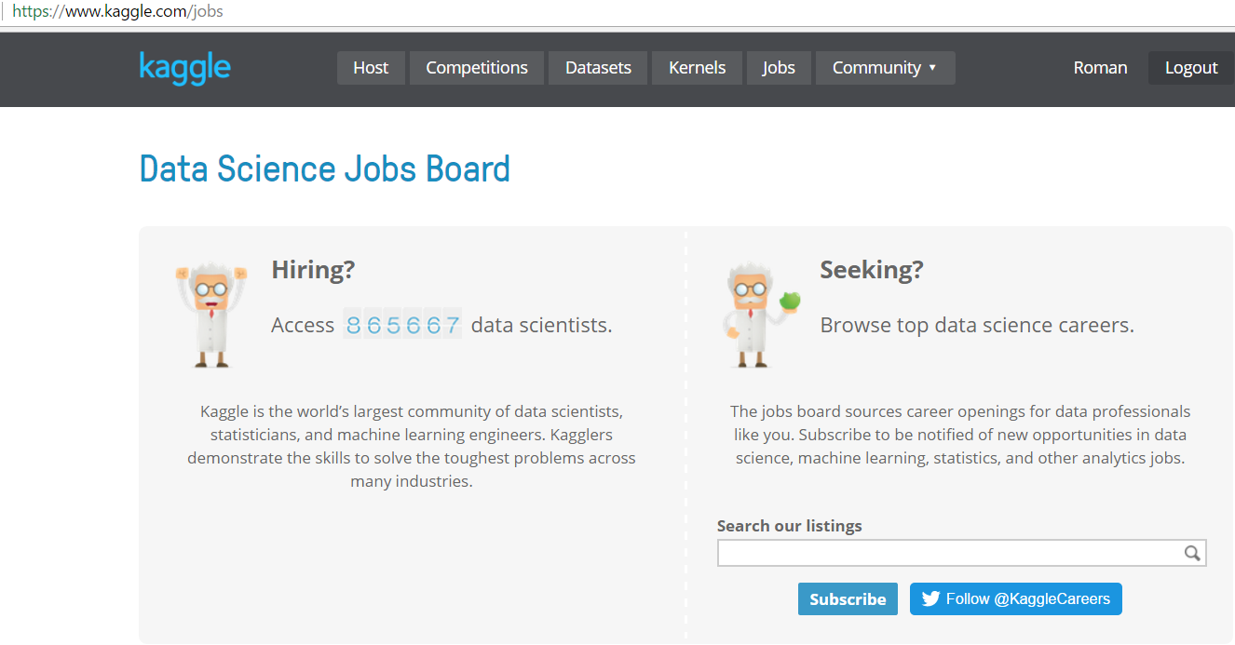
What is Kaggle?
Kaggle is a platform for data science competitions and it is the world’s largest community of data scientists, statisticians, and machine learning engineers.
It is the great place to learn and practice data analysis and machine learning.
This week announcement that it is a part of Google and it will use Google Cloud.

Slide 3
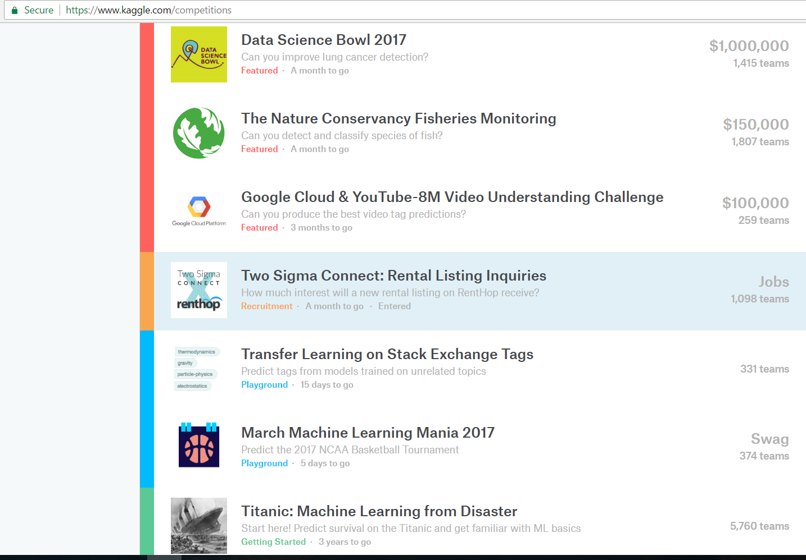
Current Kaggle competitions

Slide 4
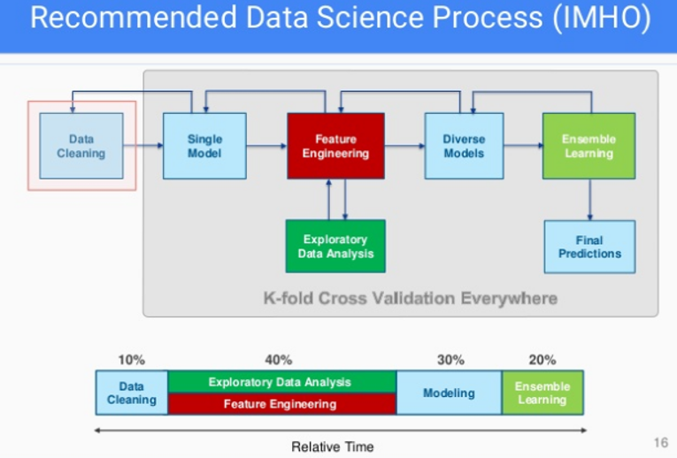
General tips for participating in Kaggle Competitions by mark Peng https://www.slideshare.net/markpeng/general-tips-for-participating-kaggle-competitions

Slide 5
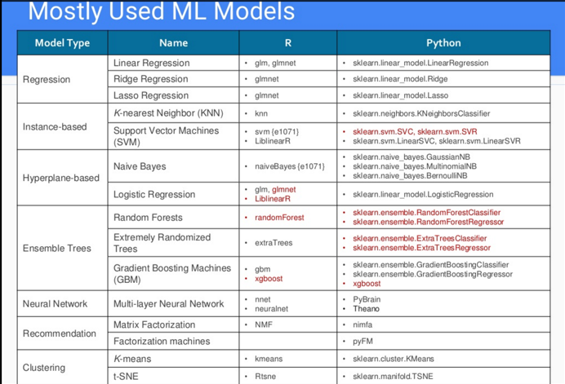
General tips for participating in Kaggle Competitions by mark Peng https://www.slideshare.net/markpeng/general-tips-for-participating-kaggle-competitions

Slide 6
tips for participating in Kaggle Competitions by Linghao Zhang (Wille) https://dnc1994.com/2016/05/rank-10-percent-in-first-kaggle-competition-en/ Home Depot Search Relevance Competition

Slide 7
General Guide for participation in Kaggle competitions
Setting up your Data Science Toolbox
Understand the competition question, metrics and what is required to be submitted
Loading and cleaning data
Exploring Data
Data preparation - Feature Engineering
Modelling – Evaluation of Model – Cross Validation – Ensemble of models
Make a submission
Kaggle’s forum help a lot! Therefore read forum often.

Slide 8
Questions?
Let’s hack it!

